Slide 1

CS 533 INTRO TO DATA SCIENCE
Michael Ekstrand

Slide 2
PRODUCTION APPLICATIONS

Slide 3

Learning Outcomes
Understand how data science outcomes can be used.
Think about how to put mdoels and outcomes into production.
Photo by C D-X on Unsplash

Slide 4
Using Data Science
Data-driven reports to inform decisions
Regular forecasts for internal purposes
Data science outputs for real-time decisions
Internal
Customer-facing

Slide 5
Reproducibility
Reproduction is crucial:
Regular reports / predictions re-run
Daily / weekly / monthly reports
Retraining models for online use

Slide 6
Online Use
Many modalities: web, mobile app, desktop app, server infra
Mobile & desktop often use web tech to connect to models
HTTP (often REST) API
Some low-latency exceptions
Multiple audiences
Internal reporting
Internal decision-making
Customer decision-making

Slide 7





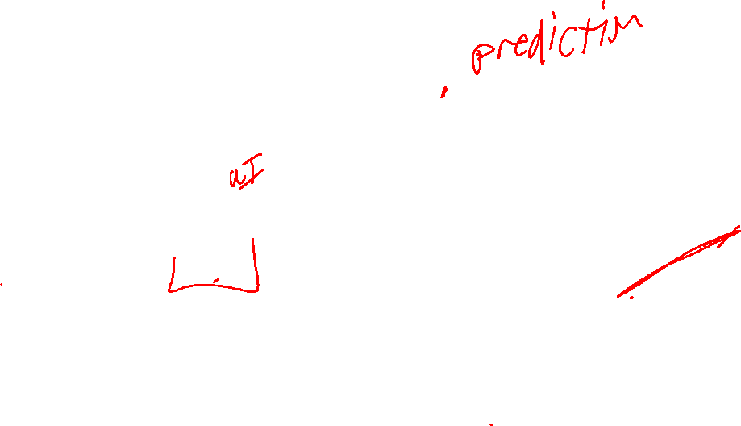
Service-Oriented Architecture
Client
Web Server
Services
Databases

Slide 8
Deployment
Predictions made available via a web service
E.g. TensorFlow Serving
Model trained offline on other hardware
Model-training script saves trained model to disk
Web service loads trained model & serves predictions

Slide 9
Useful Infrastructure Capabilities
Train models on live or freshly-exported data
Hold out test data to evaluate new model before deployment
Version your models (including retrain w/ same hyperparams!)
Roll back to old model version
Details depend on institution & infrastructure.

Slide 10
Skills to Learn
Web back-end programming (to build services)
Web front-end programming (to build dashboards)
Performance measurement & tuning

Slide 11

Wrapping Up
Many data science projects result in online production capabilities.
Often done by training a model and deploying it in a web service.
Photo by Massimo Botturi on Unsplash

